Slide 1
Helping Extramural Innovators Reach the Clinic: NCI Developmental Therapeutics Program

Slide 2
PROGRAM
1:45 PM Welcome Remarks Jerry Collins, PhD
1:50 PM Grant Funding Opportunities Suzanne Forry, PhD and Connie Sommers, PhD
2:05 PM Services Along The Critical Path Rose Aurigemma, PhD
2:30 PM Stepping Stones Program Paul Grothaus, PhD
2:40 PM Q & A
https://dtp.cancer.gov/

Slide 3
DTP: Serving Extramural Researchers Since 1955
DTP Staff: Core Group of Multidisciplinary Scientists
Serving Grantees
and Applicants
700 Active Grants
in Portfolio
Multiple Mechanisms
for Support
Drug Development Services:
Data, Compounds,
Studies for IND,
Drug Supplies for Clinical Trials
In addition to programs specifically tailored to
each of these constituencies,
we are now increasing the emphasis upon connections between these areas

Slide 4
Grant Funding Opportunities
Suzanne Forry, PhD
Connie Sommers, PhD

Slide 5
DTP Pathways to the Clinic
DTP Grants
DTP Stepping Stones Program
DTP Services and Resources
Basic Research
Clinical Research
Preclinical Research
NCI Experimental Therapeutics (NExT) Program
https://dtp.cancer.gov/

Slide 6
DTP Preclinical Therapeutics Grants Branch (PTGB): Areas of Focus
Basic Research
Preclinical Research
Clinical Research
Preclinical therapeutics research up to but not including clinical trials
Discovery, development and evaluation of small molecules (synthetic or natural product origin)
Drug delivery using various enabling technologies (e.g. ADC, nanotechnology)
Cancer drug targets: extracellular or intracellular processes (excluding immune interactions)
Development studies including mechanism(s) of action of therapeutic agents, mechanisms of resistance, rational drug combinations, novel preclinical models, drug efficacy, drug pharmacology, and drug toxicology
https://dtp.cancer.gov/

Slide 7
Current DTP - PTGB Funding Opportunities
FOA # | Title
PAR-16-049 | Small-Cell Lung Cancer (SCLC) Consortium: Therapeutic Development and Mechanisms of Resistance (U01)
PAR-17-438 | Assay development and screening for discovery of chemical probes or therapeutic agents (R01)
PA-17-440 & -449 | The Interplay of Cell Death Pathways in Cancer Cell Survival and Resistance to Therapy (R21 and R01)
RFA-CA-18-019 & -020 | Research Answers to NCI’s Provocative Questions (R21, R01) PQ9: Bifunctional small molecules (e.g. PROTACs) PQ12: Severe adverse sequelae
PA-18-020 | NCI Clinical and Translational Exploratory/Developmental Studies (R21 Clinical Trial Optional)
PA-18-484 | NIH Research Project Grant (Parent R01 Clinical Trial Not Allowed)
https://dtp.cancer.gov/

Slide 8
Stages of discovery research: PAR17- 438
“Assay development and screening for discovery of chemical probes or therapeutic agents (R01)”
1
Develop primary & secondary assays and run pilot screen
2
Execute high or moderate throughput screen
3
Validate hits; perform limited chemical analysis
A trans-NIH Funding Opportunity focused on small molecules
The aims of an application may span one or more of the stages
Flexible “on- and off-ramps” along the discovery pipeline
Up to 4 years of funding; time and budget should match scope
https://dtp.cancer.gov/

Slide 9
DTP - PTGB Pathways to the Clinic
DTP - PTGB Grants
DTP Stepping Stones Program
Bench to bedside and back
Novel therapeutics
DTP Services and Resources
Basic Research
Clinical Research
Preclinical Research
NCI Experimental Therapeutics (NExT) Program
https://dtp.cancer.gov/

Slide 10
DTP Pathways to the Clinic
DTP Grants – BRB and IOB Grants
DTP Stepping Stones Program
DTP Services and Resources
Basic Research
Clinical Research
Preclinical Research
NCI Experimental Therapeutics (NExT) Program
https://dtp.cancer.gov/
Notes:
First slide of Connie’s presentation

Slide 11
DTP Biological Resources Branch (BRB) and ImmunoOncology Branch (IOB): Areas of Focus
Discovery
Preclinical Development
Preclinical Research
Clinical Development
Basic Research
Clinical Testing
Discovery, development and evaluation of biologics for cancer therapy (e.g. antibodies, cytokines, vaccines, oncolytic viruses)
Discovery, development and evaluation of immuno-oncology agents and therapies for the immunotherapy of cancer (e.g. checkpoint inhibitor blockade agents, adoptive cell therapy/CAR-T cells, tumor microenvironment modulators)
Development studies including mechanism(s) of action of therapeutic agents, mechanisms of resistance, rational combinations, preclinical models (e.g. GEMM, canine, PDX, tissue/organoids)
Biomarker discovery, development and evaluation
https://dtp.cancer.gov/
Notes:
BRB has other functions – development of biologics/contracts/GMP – Rose will provide more detail

Slide 12
Current DTP - BRB/IOB Funding Opportunities
FOA # | Title
PAR-17-244 & 245 | Research models to enhance applicability of mammalian models for translational research (collaborative R01 and R01)
PAR-16-228 & 229 | Metabolic reprogramming to improve immunotherapy (R01 and R21)
PAR-17-331 | Discovery of small molecule immunomodulators for cancer therapy (R01)
RFA-CA-18-019 & -020 | Research Answers to NCI’s Provocative Questions PQ8: Predictive biomarkers for irAEs PQ12: Cancer therapy-induced severe adverse sequelae
PA-18-020 | NCI Clinical and Translational Exploratory/Developmental Studies (R21 Clinical Trial Optional)
PA-18-484 | NIH Research Project Grant (Parent R01 Clinical Trial Not Allowed)

Slide 13
Discovery of Small Molecule Immunomodulators for Cancer Therapy: PAR17-331
  Assay development
Targets should reside in immune cells or in cells of the TME but not in cancer cells themselves.
Primary screening assays should be high or moderate throughput. Secondary screening assays must incorporate a model appropriate to measure immune responses to a tumor.
1
  Primary screen implementation
2
  Hit validation
3
  Hit to lead optimization
4
https://dtp.cancer.gov/
Notes:
Add an example or two if time permits

Slide 14
Discovery of Small Molecule Immunomodulators for Cancer Therapy: PAR17-331
  Assay development
Targets should reside in immune cells or in cells of the TME but not in cancer cells themselves.
Primary screening assays should be high or moderate throughput. Secondary screening assays must incorporate a model appropriate to measure immune responses to a tumor.
1
  Primary screen implementation
2
  Hit validation
3
  Hit to lead optimization
Flexible “on- and off-ramps” along the discovery pipeline
Up to 4 years of funding; time and budget should match scope
4
Notes:
Add an example or two if time permits

Slide 15
DTP - Pathways to the Clinic
DTP - PTGB/BRB/IOB Grants
DTP Stepping Stones Program
Bench to bedside and back
Novel therapeutics
DTP Services and Resources
Basic Research
Clinical Research
Preclinical Research
NCI Experimental Therapeutics (NExT) Program
https://dtp.cancer.gov/

Slide 16
Services Along The Critical Path
Rose Aurigemma, PhD

Slide 17
Overview of DTP Activities
Mission: To support development of innovative new cancer therapies
Provide resources and services to the extramural research community
  Academic, non-profit, biotech, pharma
  Cost-free, IP involved in rare cases
Maintain a robust infrastructure for drug discovery and development
  Facilities at Frederick National Laboratory for Cancer Research (Frederick, Maryland)
  Ad hoc contracted facilities solicited through RFP process (nation wide)
Manage a large portfolio of grants pertinent to drug discovery and preclinical development
https://dtp.cancer.gov/

Slide 18
Overlapping Support for Discovery and Development
DTP Grants
DTP Stepping Stones Program
DTP Services and Resources
Basic Research
Clinical Research
Preclinical Research
NCI Experimental Therapeutics (NExT) Program
https://dtp.cancer.gov/

Slide 19
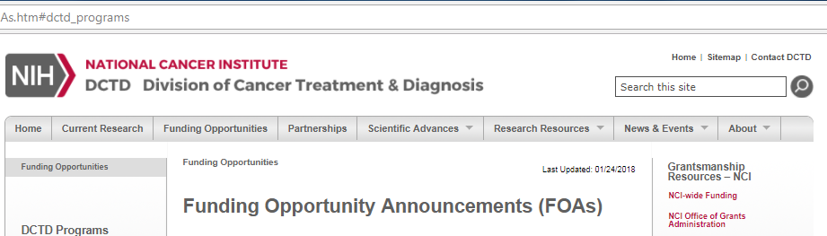
Preclinical Therapeutics Grants Branch
Grant portfolio for small molecule therapeutics discovery & development:
  Molecular targets
  Biochemistry
  Synthetic/Medicinal Chemistry
  Mechanism of action
  Therapeutic models
  Pharmacology/Toxicology
  Novel delivery & Nanomolecules

Slide 20
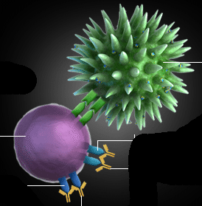
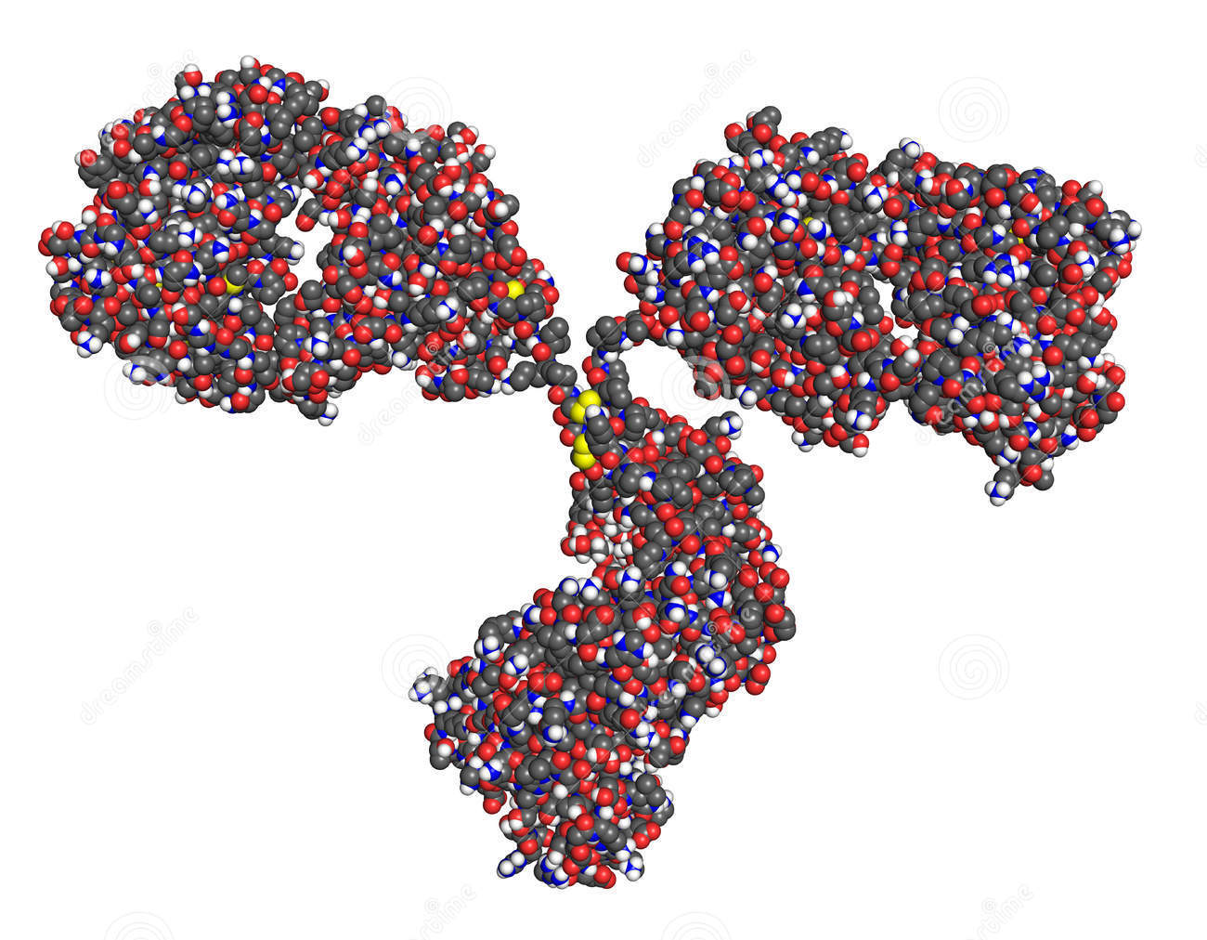

Immuno-oncology Branch
Goal: Support immuno-oncology investigators and augment pipeline for immunotherapy trials
Grant portfolio:
Immuno-oncology
Canine Immunotherapy
Cell therapy
Immunotherapy
Therapeutic models
Mechanism of action
https://dtp.cancer.gov/

Slide 21
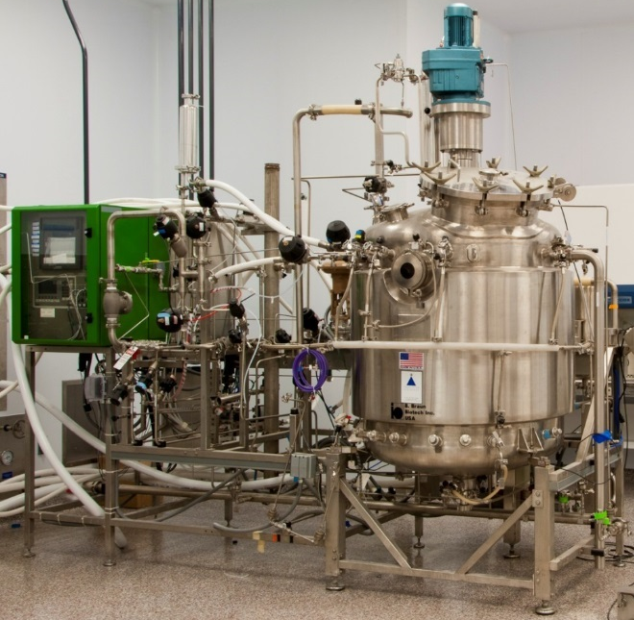
Biological Resources Branch
Biopharmaceutical Development:
  Expression optimization
  Purification process development, GMP manufacture Analytical assay development, testing and stability
Grant Portfolio:
  Biopharmaceutical technology: antibodies, antigens, recombinant proteins, plasmids, oligonucleotides, peptides, vaccines, virus vectors
Biologics Repository:
  Murine and human cytokines, growth factors, immunomodulators
  Anti-murine and anti-human monoclonal Abs

Slide 22
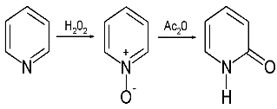
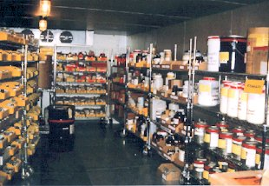
Drug Synthesis and Chemistry Branch
Synthetic Chemistry
Analogs, route scouting
Chemical Repository:
>200,000 compounds (plates & individual vials)
Diversity set
Mechanistic set
Approved oncology drug set
Investigational drug set
https://dtp.cancer.gov/

Slide 23
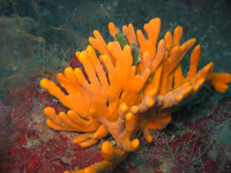

Natural Products Branch
Collection of Natural Products
Screening & identification of active compounds
  >170,000 crude extracts
  (plant, marine organisms, microbes)
Natural Products Repository:
Aqueous & organic extracts
Isolated natural products set (expanding)
Pre-fractionated library
https://dtp.cancer.gov/

Slide 24

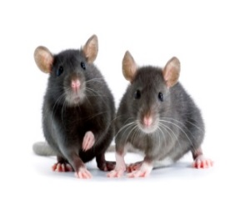
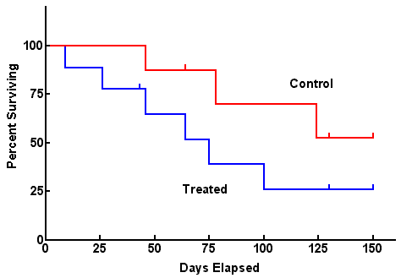
Biological Testing Branch
Model development and in vivo testing
Therapeutic efficacy, dose schedule, MTD, combination drug studies
Biological Testing Repositories:
Human & murine tumor cell lines (NCI-60 etc.)
Human & murine tumor tissues
Special tumor collections (sarcoma, SCLC)
PDM repository
https://dtp.cancer.gov/

Slide 25
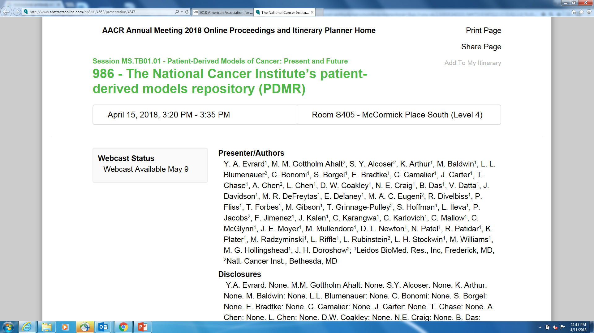
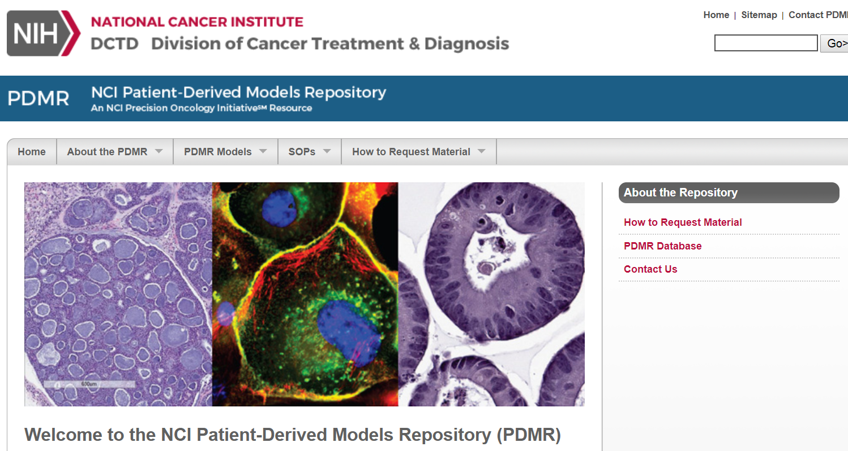
Today at 3:20 PM
https://pdmr.cancer.gov/
https://dtp.cancer.gov/

Slide 26

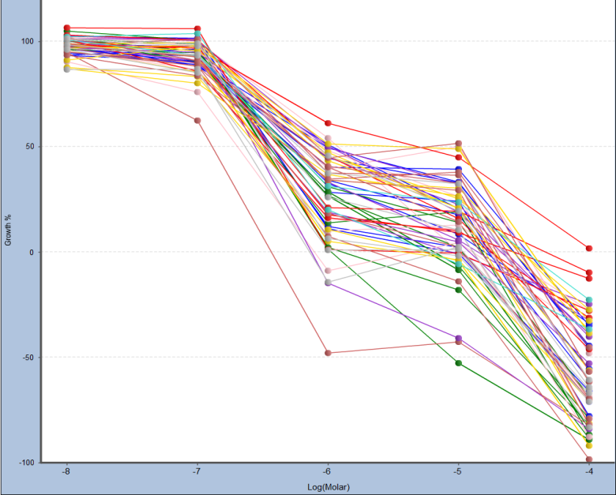
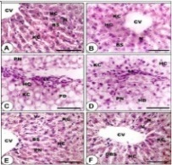
Molecular Pharmacology Branch
Drug screening in NCI-60, PDM
Assay in 2D, 3D cultures
Molecular target validation
NCI-60 Human Tumor Cell Lines
6 breast 2 prostate
8 renal 7 ovary
7 colon 6 brain
9 lung 9 melanoma
6 hematopoietic
GI₅₀
Percentage Growth
TGI
LC₅₀
https://dtp.cancer.gov/

Slide 27
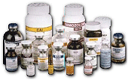

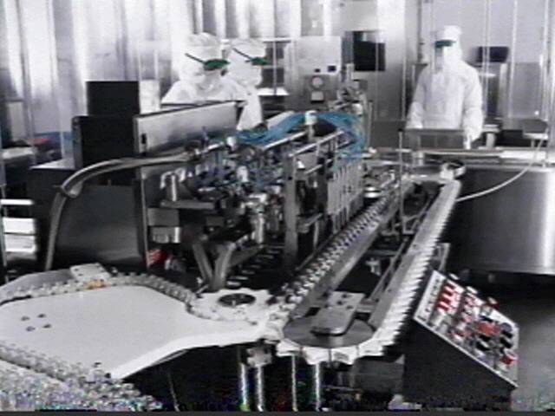
Pharmaceutical Resources Branch
API to FDP development & manufacturing:
GMP production: scale-up, purification final drug product
Dose formulation studies, dosage forms
Storage/shelf life stability
Compatibility with delivery devices
Analytical chemistry: release specifications for identity, purity, potency

Slide 28
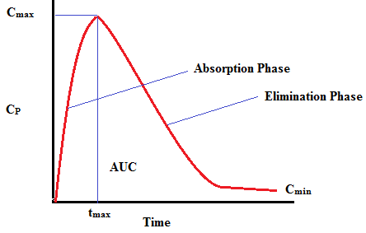
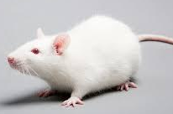
Toxicology and Pharmacology Branch
GLP and non-GLP studies:
Pharmacokinetic and toxicological profile, ADME
Development of special target organ toxicity assay
Preclinical MTD, DLTs and clinical starting dose
in vitro studies
IND-directed safety studies including toxicokinetics
Documentation for IND filing
https://dtp.cancer.gov/

Slide 29
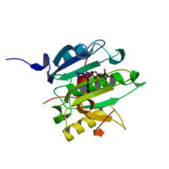
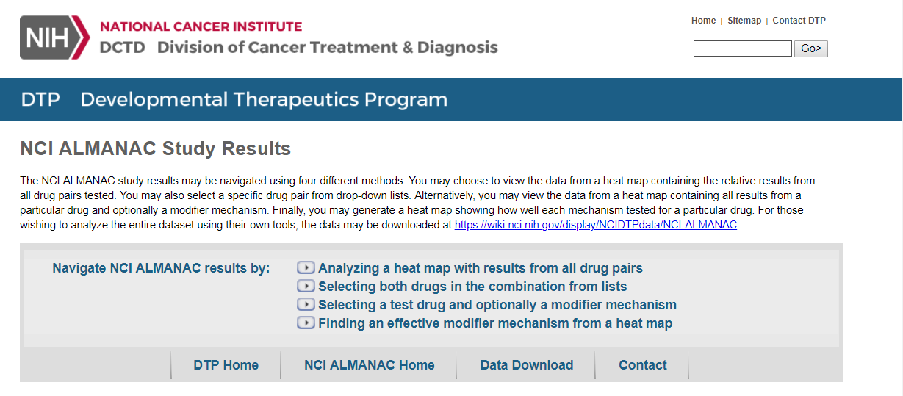
Information Technology Branch
Structure-based medicinal chemistry
Bulk data for download, browsing & searching:
  NCI-60 screening, in vivo anti-cancer, in vitro and in vivo gene expression data (microarray)
  Chemical structure data
  Molecular target characterization data
  Sarcoma project data
NCI-ALMANAC
  Data showing how well pairs of FDA-approved cancer drugs kill tumor cells from the NCI-60 Human Tumor Cell Lines
COMPARE - Pattern-recognition algorithm
  Compare degree of similarity in activity profiles of NCI-60 in vitro screen
https://dtp.cancer.gov/

Slide 30
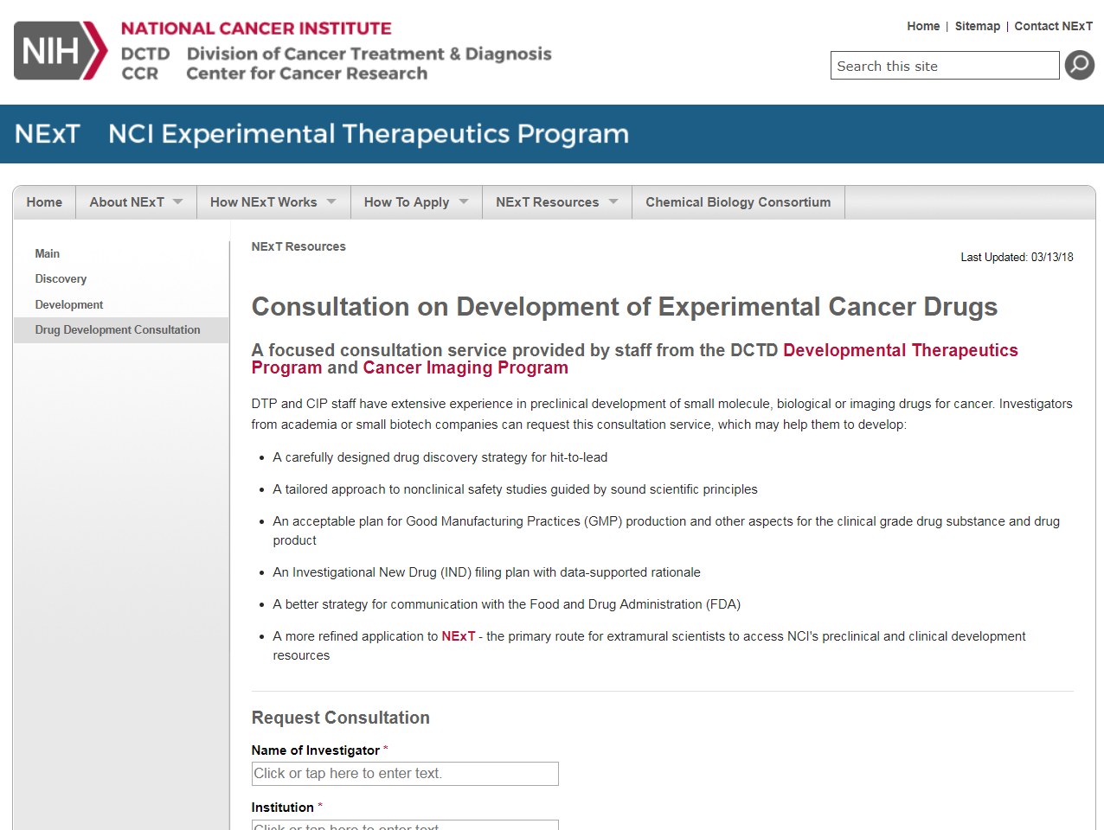
Drug Development Consultation Service https://next.cancer.gov/experimentalTherapeutics/form.htm
Open to all innovators
Confidential
Assess critical path for product development

Slide 31
Where to find information:
DTP information: https://dtp.cancer.gov/
DTP contact: dtpinfo@mail.nih.gov
NCI Experimental Therapeutic program (NExT)
https://next.cancer.gov/

Slide 32
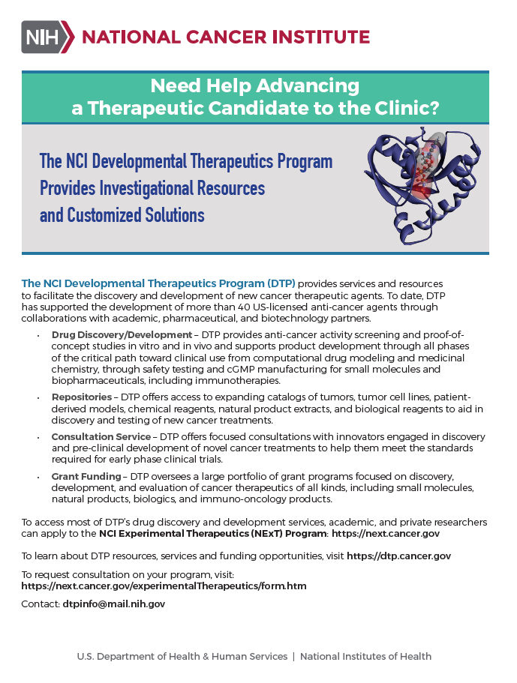
Pick up a DTP brochure

Slide 33
Stepping Stones Program
Paul Grothaus, PhD

Slide 34

Reduce Risk with Overlapping Mechanisms
New initiative:
Advancing new therapeutic concepts toward clinical testing by providing resources and data “stepping stones”
DTP Grants
DTP Stepping Stones Program
DTP Services and Resources
Tox/PK/PD
Basic Research
Clinical Research
Preclinical Research
Synthesis
Efficacy
NCI Experimental Therapeutics (NExT)
Commercial development
https://dtp.cancer.gov/

Slide 35
Overcoming Barriers to Innovation and Product Translation
Academic priorities
Inexperience
Continuity of funding (esp. for development)
Inadequate access to preclinical resources
Regulatory risk
https://dtp.cancer.gov/

Slide 36
Why NCI Support for Development?
Expand access to federal resources for product development
Support NIH investment in peer-reviewed programs
Improve chances for attracting investment and partnering
Fill the NExT pipeline with new therapeutic drugs/strategies
https://dtp.cancer.gov/

Slide 37
Stepping Stones Outreach Goals
Lowering Risk
  Provide assessment of product development vulnerabilities
  Target critical gaps in product development to build data
  Team approach to cover the entire critical path
  Load pipeline with competitive NExT applicants, enable further investment and partnering
Tracking Progress of Investment
https://dtp.cancer.gov/

Slide 38
Current Process
Program Director consultation with Investigators to assess interest/review data
Conference call/meeting with DTP to discuss gaps and opportunities
Short list of discrete studies to be performed, in priority order
Gain approval from Division leadership
MTA negotiation for transfer of compound and data
  All communications with federal program staff is confidential even prior to MTA
Work performed by NCI, data/materials provided to PI
https://dtp.cancer.gov/

